Slide 1
ROLE OF COMPUTER IN HOMOEOPATHY
Dr. P.R. Sisir M.D. (Hom.)
Professor & HoD
Department of Paediatrics

Slide 2
PRANAMS AT THY FEET OF

Slide 3
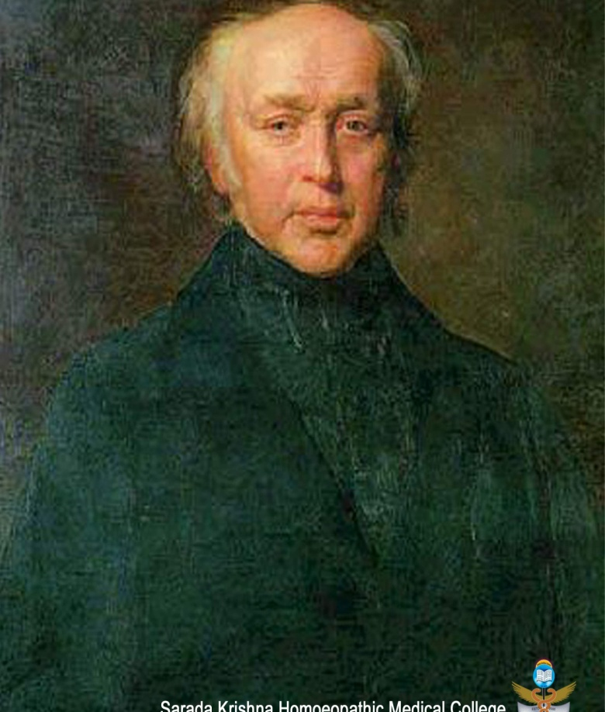
Dedicated to the Father of Repertory
Dr. C. Boenninghausen

Slide 4
INFORMATION STORAGE & RETRIEVAL

Slide 5
EXPERT SYSTEMS

Slide 6
COMPUTER ASSISTED INSTRUCTIONS

Slide 7
SYSTEM WITH ARTIFICIAL INTELLIGENCE

Slide 8
NETWORKING

Slide 9
EDIFICATION

Slide 10
COMPUTER PROGRAMS IN HOMOEOPATHY

Slide 11
1979, Le Repertaise De Kent “Melanie” – Docteur Georges Brous.
The Lamina Homoeopathic Repertory Analysis System -
(Australia) – 14700 Symptoms

Slide 12
Hompath – Dr. Jawahar J. Shaw
Kentian – Sai Homoeopathic Book Corporation

Slide 13
Mac Repertory
RADAR
HRS – CIRA
Polychresta – Dolphin Cybernetic Systems Pvt. Ltd., Thane.

Slide 14
CARA, SIMILIA & CARALITE – Royal London Homoeopathic Hospital
– 4 Front Computer England Ltd.
MICROPATH – Micro-therapeutics, England
Homoeorep – Boenninghausen’s Technique – Dr. Roberts Bacheleric,
France
The Profile – D. J. Vidlard, France
Organon ’96 – Dr. Dilip B. Dikshit – Bombay, ICR. 21st century,
Homoeopathic Work-Station version 2.00.
(Based on SCR System in use at the I.C.R.

Slide 15
The Samuel – The Co-operative Association, Holland
Kenbo – Info-Axon Technologies Ltd., New Delhi/U.K.
ISIS – David Witko
Stimulare -

Slide 16
FEATURES & SIGNIFICANCE
OF THE MOST LEADING SOFT WARES

Slide 17
RADAR (Rapid Aid to Drug Aimed Research)
Since 1993
Option of using the entire source repertories till date!
Complete & Synthesis Repertory in one platform!
Vithoulkas Expert system
Herscue module
Dr. Prakash Vakil Module
Multi media Facility
Patient program
Encyclopaedia Homoeopathica
Materia medica Repertorization

Slide 18
HOMPATH (Classic ver. 8.0 – The Premium Collection)
Classic – Repertorisation module with 29 Repertories
- Quick Repertorisation
- Fast, Intelligent Search –entire database.
- Repertorisation strategies & expert anlaysis.
- Remedy Analysis.
Archives
Utilities
Patient Management
Case Analysis
Links Tresorie & Tresorie
Materia Medica Live
Hompath Assist
Multilingual email

Slide 19
CARA & SIMILIA
CARA is a Repertory Software & SIMILIA is for reference works to
Search & browse between Materia Medicas & Repertory
Feature of Browsing between Repertories, making combined
search between Repertories
Provides Kent Repertory, Synthetic Repertory, Boericke’s Repertory,
Phatak’s Repertory, BBR, Clarke’s Clinical Repertory
Provides Kent’s Lectures on Materia Medica, Boericke’s Materia
Medica, Phatak’s Materia Medica & Allen’s Materia Medica
Create a New Repertory

Slide 20
Other Soft wares
CARALITE
MAC REPERTORY
STIMULARE
KENBO
ISIS

Slide 21
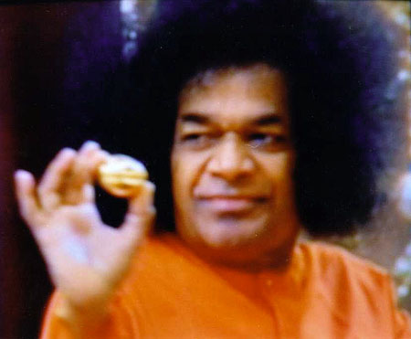
THANK YOU ALL

